Slide 1
Counselor Education Webinar
Wednesday, October 26, 2017
6:30 P.M.

Slide 2
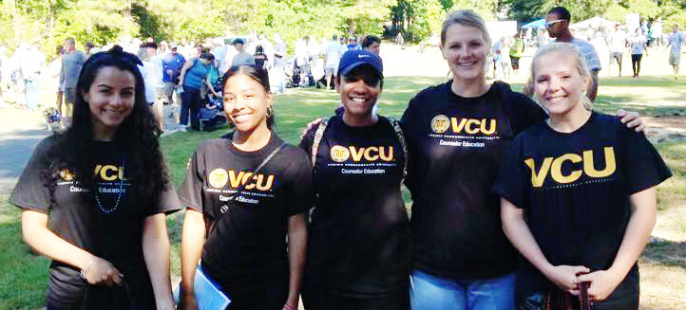
Department of Counseling & Special Education
M.Ed. Counselor Education
School counseling concentration
College student development and counseling concentration
Ph.D. Counselor Education and Supervision

Slide 3
M.Ed. Counselor Education
CACREP Accredited
Full-time or part-time
48 credit hours
Field experience:
Practicum (100 hours) and
Internship (600 hours)
Comprehensive Exam

Slide 4
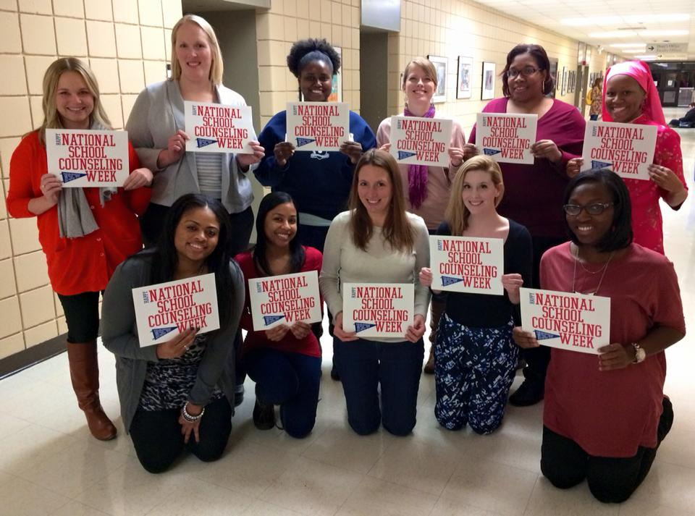
Program Requirements: M.Ed. School Counseling
Eligible for licensure or provisional licensure as pk-12 school counselor
Core Courses
Theories of Counseling, Techniques, Group Procedures, Career Information and Exploration, Assessment Techniques, Multicultural Counseling, Seminar in Counseling, Data Driven Comprehensive School counseling, School Counseling Services
Foundation of Education Courses
Lifespan Development: A Gender
Perspective, Research Methods, and Ethics
and Policy
Field Experience:
Practicum: School Counseling
Internship: pk-12 School Counseling

Slide 5
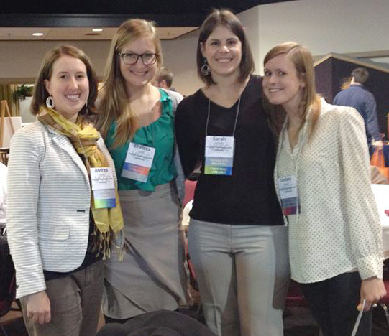
Program Requirements: M.Ed. College Student Development and Counseling
Professional counselors, leaders, and advocates apply knowledge in diverse settings with diverse populations of adult learnings in higher education
Core Courses
Theories of Counseling, Techniques, Group Procedures, Career Information and Exploration, Assessment Techniques, Multicultural Counseling, Seminar in Counseling, Student Development Services in Higher Education
Foundation of Education Courses
Lifespan Development: A Gender Perspective,
American Colleges and Universities, and Research
Methods
Field Experience:
Practicum: College Student Dev. and Counseling
Internship: College Student Dev. and Counseling

Slide 6
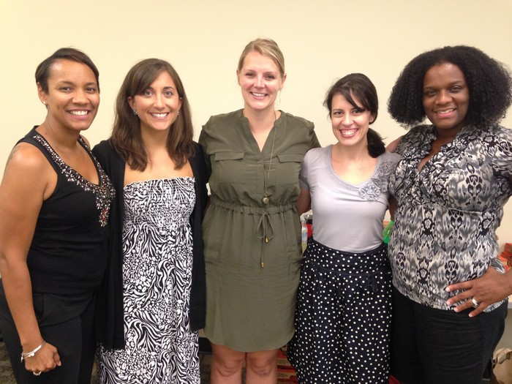
Ph.D. Counselor Education & Supervision
CACREP Accreditation Pending
Full-time or Part-time
51 credit hours
Prepares students for careers as counselor educators, counselor supervisors, researchers, and leaders in the counseling profession

Slide 7
Ph.D. Program Requirements
Pre-requisites:
Coursework from a CACREP-accredited master’s program and STAT 508 or equivalent. At least two years previous counseling experience preferred
Core counseling courses
Counselor Education Doctoral Seminar I, Counselor Education Doctoral Seminar II, Advanced Counseling Theories and Practicum, Counseling Supervision, Advanced Group Counseling, Advanced Career Counseling and Development, Counselor Education Doctoral Internship (4 cr)
Foundations of Education courses
Foundations of Educational Research and Doctoral Scholarship I, Foundations of Educational Research and Doctoral Scholarship II, Externship (3+ cr)

Slide 8
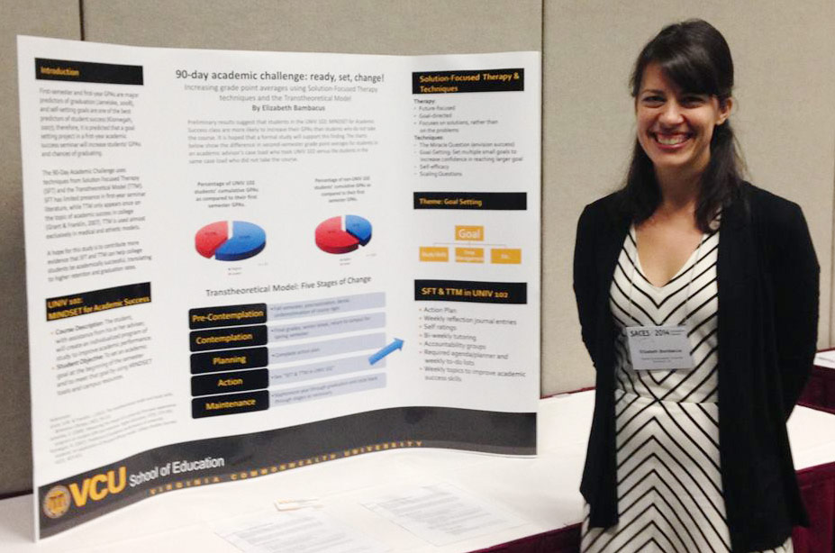
Ph.D. Program Requirements
Research Courses
Statistics for Social Research, Educational Research Design, Qualitative Methods and Analysis, and research elective)
Dissertation
Dissertation Seminar (may be waived) and Dissertation (minimum of 12 cr)
School of Education Qualifying Exam
Comprehensive Exam

Slide 9
Student Demographics
Incoming M.Ed. and Ph.D. Class (2016)
Program | Race/Ethnicity | Gender Female | Gender Male | Total N | Total %
Masters Programs | Asian | 1 | 0 | 1 | 3.4%
 | Black/African American | 7 | 0 | 7 | 24%
 | White | 9 | 5 | 14 | 48%
 | Not Specified | 7 | 0 | 7 | 24%
 | Total | 24 | 5 | 29 | 100%
Ph.D.-Counselor Education and Supervision | White | 2 | 1 | 3 | 100%
 | Total | 2 | 1 | 3 | 100%

Slide 10
Admission Requirements: M.Ed.
In addition to the general admission requirements of the VCU Graduate School (graduate.admissions.vcu.edu), the following requirements represent the minimum acceptable standards for admission
Bachelor’s degree in an appropriate discipline
Three letters of recommendation addressing the student’s potential for graduate study in education
Student’s written statement concerning career interests
Transcripts of all previous college work
Personal interview may be required
Satisfactory scores on the GRE or MAT

Slide 11
Admission Requirements: Ph.D.
In addition to the general admission requirements of the VCU Graduate School (graduate.admissions.vcu.edu), the following requirements represent the minimum acceptable standards for admission
Master’s degree from a CACREP-accredited program or related discipline
Three letters of recommendation addressing the student’s potential for graduate study in education
Student’s written statement concerning career interests
Transcripts of all previous college work
Personal interview and writing sample (may be required)
Professional vitae/résumé
Satisfactory scores on the GRE

Slide 12
Funding
Financial Aid:
Students in a degree-seeking program are eligible to receive federal financial aid by submitting the FAFSA (fafsa.ed.gov)
Finaid.vcu.edu
Scholarships:
More than six School of Education scholarships for counseling
See http://www.soe.vcu.edu/current-students/scholarships/
Graduate assistantships
Research Seed Monies
Travel grants

Slide 13
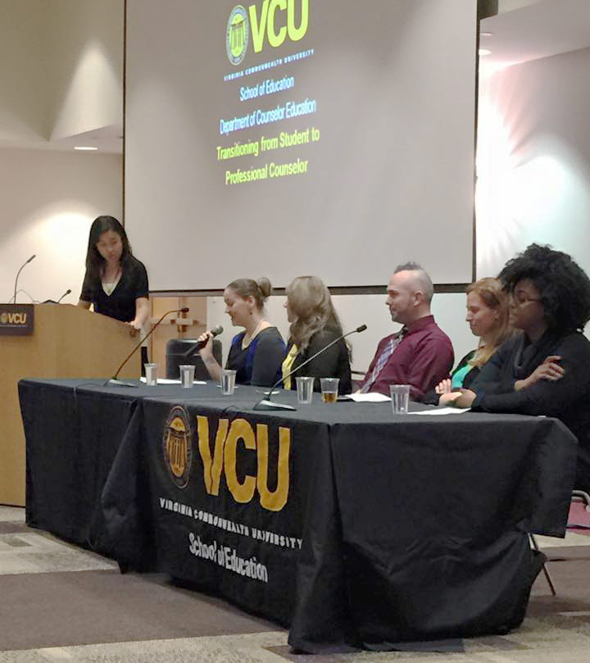
Student Organizations
CESNA
Counselor Education Student Networking Association
John Cook Lecture
Alumni Dinner
SANA
Student Affairs Networking Association
Professional Development
CSI
Chi Sigma Iota International Honor Society
Omega Lambda Iota Chapter
Professional Development
Community Engagement
Initiation

Slide 14
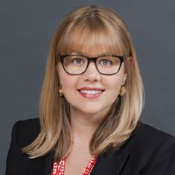
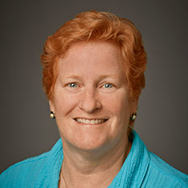
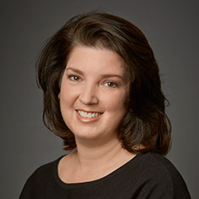
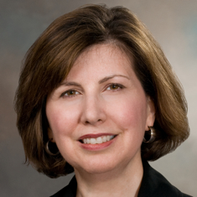
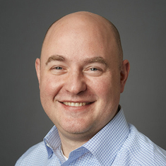
Faculty
Dr. Abigail Conley
Interpersonal violence prevention, Wellness
Dr. Donna Dockery
Social justice, Diversity
Dr. Donna Gibson
Professional Identity Development, Leadership
Dr. Mary Hermann
Work/Life Balance, Legal and ethical issues
Dr. Philip Gnilka
Perfectionism, Stress, Coping & Wellness

Slide 15
Why do students choose VCU?
2016 Alumni and Current Student Survey (Masters)
Accreditation, reputation, quality of education
Location and faculty
Opportunities related to diversity
Good job prospects/High employment rate
Curriculum matched interests
Flexibility and program length
Ability to acquire personal goal
Check out vital statistics at: http://www.soe.vcu.edu/departmentpages/counseling-and-special-education/counselor-education-program-group/program-assessment-and-evaluation/

Slide 16
Why do students choose VCU?
2016 Alumni and Current Student Survey (Doctoral)
Reputation of the Program
Local
Part-time or Full-time
“Passionate, dedicated, and supportive faculty”
Prepares students to be researchers and teachers
Individualized programming
Funding
Faculty research interests
High achieving faculty
**ASK ABOUT CACREP ACCREDITATION**

Slide 17
Next Steps!
Check out new admissions page on program website at: http://www.soe.vcu.edu/departmentpages/counseling-and-special-education/counselor-education-program-group/admissions/
Contact Dr. Donna Gibson at 804-828-1332 or dgibson7@vcu.edu if interested in applying for either M.Ed. or Ph.D. programs or have questions

